Slide 1
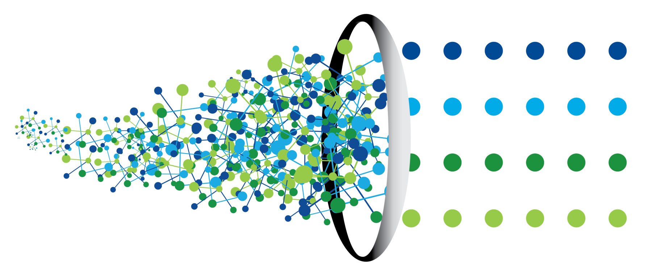
Product Change Cost Analytics (PCCA)
Creating business value by leveraging the power of prediction

Slide 2
The driving issue
Across industry, projects are consistently going over budget and business cases are collapsing. Cost increases are limited not just to development, but span across the entire product value chain.
In development, there is increasing cost of product changes, cost of re-testing, and decreasing ability to meet schedule commitments.
In production, companies see increased rework costs, tooling costs, and an overall struggle to meet cost commitments.
Downstream, in support phases, frequent design changes result in higher service costs for products under warranty and erode margins. Furthermore, a lack of consideration of serviceability and durability during design results in higher unscheduled service events, causing a disruption in spare parts inventory management and maintenance planning and increasing turnaround time for service.
Companies are not able to address the cost challenge effectively without the ability to pin point real drivers of cost and their true impact on the total product lifecycle cost. Oftentimes, these companies emphasize reducing the volume of churn rather than focusing on reducing the few changes that result in majority of the cost. The few companies that do identify the drivers of cost often expend enormous amounts of effort and still do little to improve the situation for future programs.

Slide 3
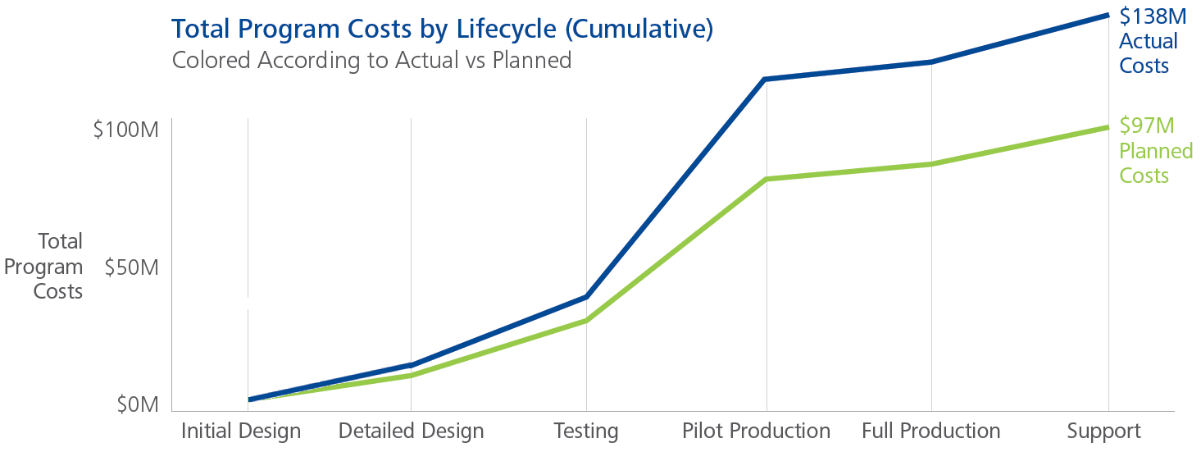
The opportunity exists to transform the product development process
Product development efforts fall short of their objectives because they are late and miss their cost or performance targets
How do I better manage late changes that drive poor quality and downstream costs?
How can I draw insights from the past performance to improve the complex and multi-disciplinary product development process?
How and where can I best deploy my limited R&D resources?
How can I make good decisions during the execution of product development programs?
Transform your Product Development process through fact-based, data-driven decision making

Slide 4
Profitability of new products is driven by planned and unplanned R&D cost
The scope of a product development program is a measure of the planned, irreducible change between current and new product. The churn is a measure of the unplanned, reducible change.
Scope
Planned Change
Successful product development efforts minimize churn through effective management and decision making.
R&D Profit = f(R&D Cost…..)
R&D Cost = f(scope, churn)
Total
R&D
Costs
Churn
Unplanned Change
PCCA measures the effects of unplanned change across several product development programs

Slide 5
Multiple components contribute to the true cost of churn
Design Labor, often perceived as the largest driver of product change cost, is barely one-fifth of the total cost impact
COST COMPONENTS
Scope
Planned Change
Total Program Costs
Churn
Unplanned Change
Cost of Churn Through the Entire Lifecycle

Slide 6
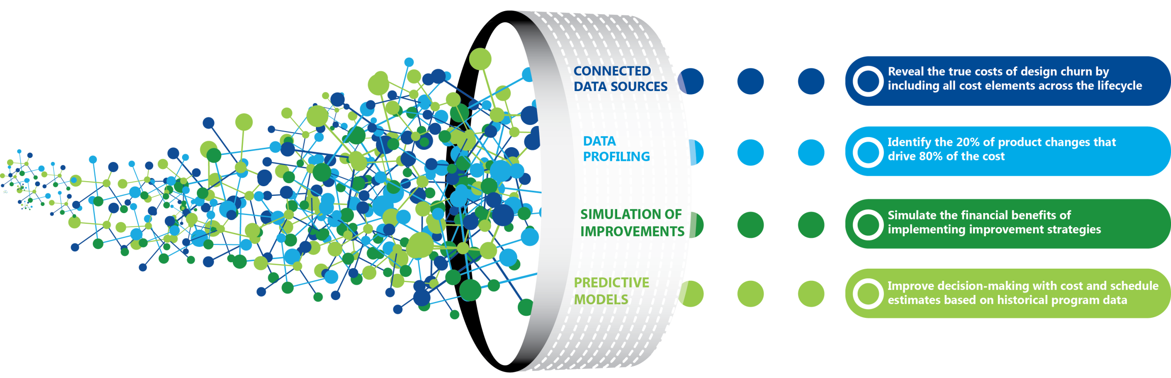
Applying advanced analytics on product development cost data can generate tremendous business value
In order to deliver business value, we need to have a holistic analytics solution that consists of four key elements:
PCCA Framework

Slide 7
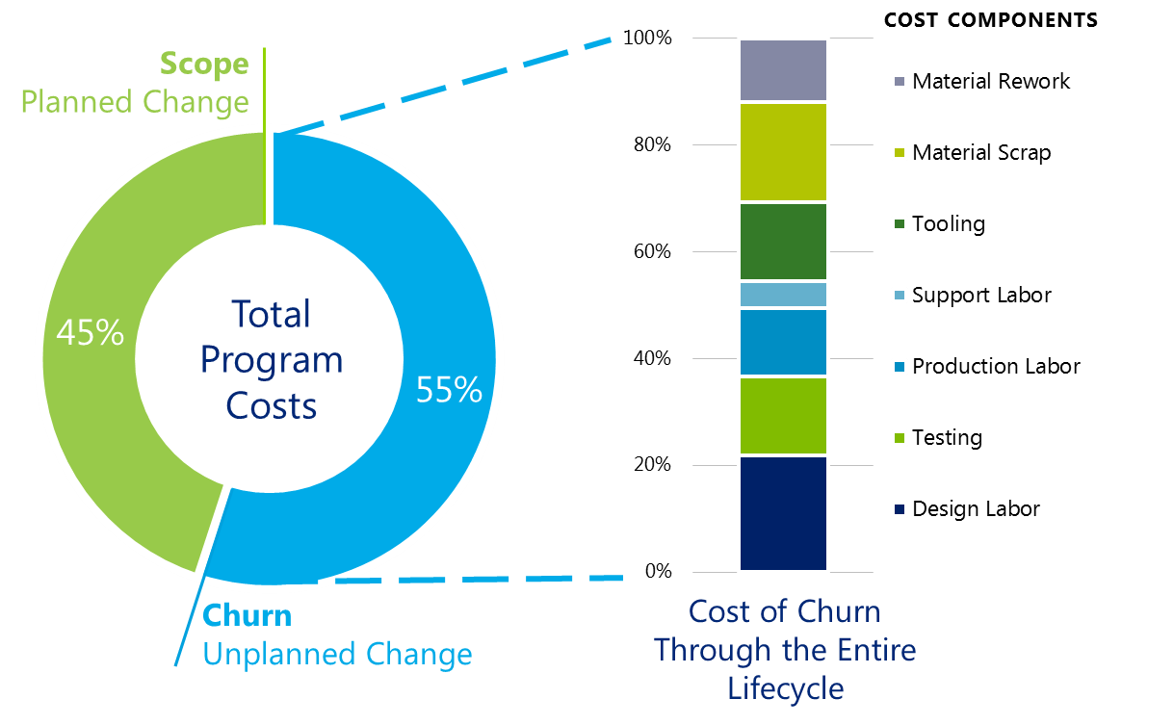
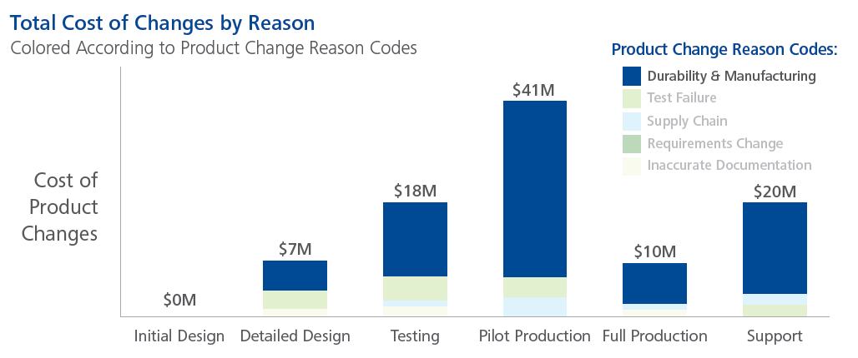
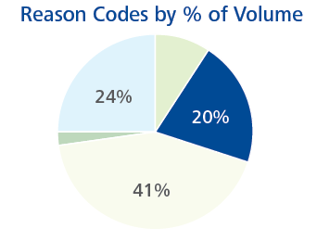
Finding the true costs of design churn
  The Product Change Cost Analytics framework first connects multiple data sources to find the drivers of cost across the life cycle. These combined data sources form the basis of data-driven decision tools that find high-cost drivers, simulate improvement strategies, and predict costs of future product changes.
  Total product lifecycle cost
  Product changes across the lifecycle of a product often represent the majority of program costs
  Design labor is usually perceived as the largest driver of these costs. However, it is typically less than one-fifth of the total cost impact.
  Disparate data points within an organization must be connected to understand the true impact of product changes
Data profiling
  Organizations typically focus only on the volume of design churn
  The goal of our analysis is to identify the 20% changes that contribute to 80% of the cost
  Understand which improvements can be most effective in reducing the high cost changes

Slide 8
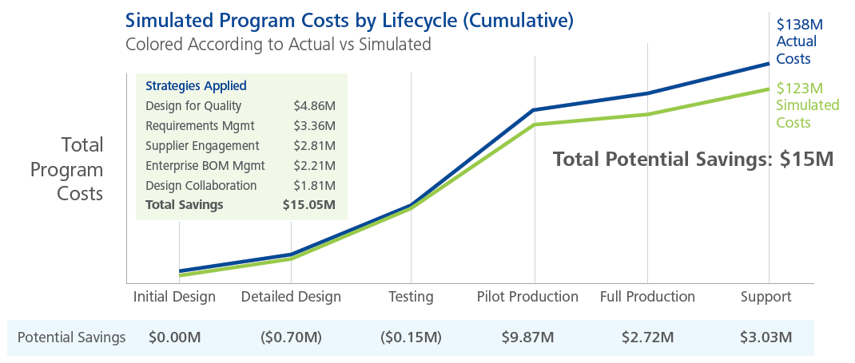
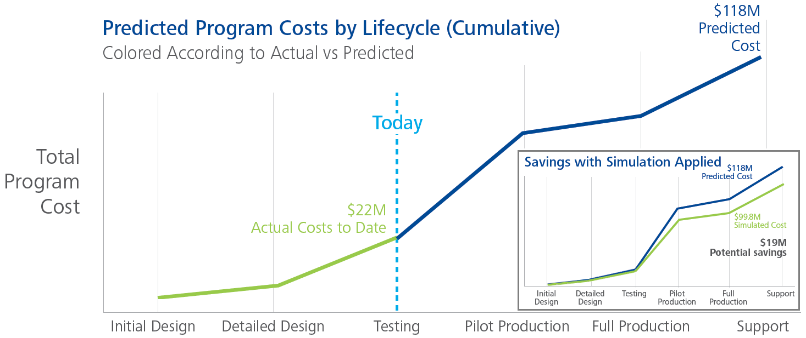
Performing scenario analysis with simulations and predictive modeling
  Simulation of Improvements
  Simulation based on over 50 benchmark datasets collected through prior Deloitte projects
  Simulate the impact of capability improvements on reducing total lifecycle cost
  Recommend the most impactful improvement areas for each specific business situation
  Enable a data driven benefit analysis that translates into a hard dollar business case
Predictive Modeling for Decision Tools
  Predict the cost impact of product changes prior to executing them
  Predict the design churn volume and costs of entire programs
  Based on correlations of product change parameters to total product lifecycle costs
  Ability to include unstructured data sources to further enhance prediction accuracy

Slide 9
How it works

Slide 10





Connect siloed data sources to form a powerful basis for analytics
Connected Data Sources
Data Profiling
Simulation of Improvements
Predictive Modeling
COMBINED DATA FIELDS | DATA SOURCES
Model / Program | ER | BF | FR | PD | PR | PM
Job Number | ER |  | FR
Change Number | ER |  |  | PD | PR
Lifecycle Phase | ER | BF | FR |  |  | PM
Module / Subsystem | ER |  |  | PD
Part Number |  |  |  | PD | PR
Part Cost |  |  |  | PD | PR
Part Type |  |  |  | PD | PR
Part Location ID |  |  |  | PD | PR
Estimated & Actual Hours | ER |  | FR
PC Category | ER
PC Affectivity | ER
PC Reason Code | ER
PC Conditions for Change | ER
PC Description (Text) | ER |  | FR | PD | PR
PC Root Cause (Text) | ER |  | FR | PD | PR
Job Description (Text) | ER |  | FR | PD | PR
Certification and Test Dates |  |  | FR |  |  | PM
Part Replacements |  |  |  | PD | PR
WBS Elements |  | BF | FR
Engineering
Records
Program
Milestones
Budget &
Forecast
Total Product Lifecycle Cost
Financial
Reports
Part
Revision
History
Part
Demographics
The quality of analytics results is proportional to the quality of available data.

Slide 11
Profile the data to shift the focus of improvement efforts
Connected Data Sources
Data Profiling
Simulation of Improvements
Predictive Modeling
Often times, 20% of the product changes drive 80% of the total product lifecycle cost. Data profiling looks for patterns in the data to identify the 20%.

Slide 12
Simulate the effect of improvement strategies on past programs
Connected Data Sources
Data Profiling
Simulation of Improvements
Predictive Modeling
Each scenario has a different set of challenges, requiring different solutions. The effect of multiple improvement strategies can be simulated using past program data as a baseline.

Slide 13
Design the simulation to account for individual product changes
Connected Data Sources
Data Profiling
Simulation of Improvements
Predictive Modeling
Improvement strategies can reduce the impact of product changes in two ways:
PC Reduction: Eliminating unnecessary changes
PC Shifting: Performing changes earlier, where changes have a lower impact on the total cost
1) Reduction of product changes
2) Shifting to an earlier life cycle phase
Number of ECs
Number of ECs
Design
Testing
Production
Support
Design
Testing
Production
Support
Life Cycle Phases
Life Cycle Phases

Slide 14
Predict upcoming costs of current and future programs
Connected Data Sources
Data Profiling
Simulation of Improvements
Predictive Modeling
By leveraging the connected data sets of historical and current programs, predictive models can inform decision makers of future program costs.
Today
Predicted Costs (Future)
Actual Costs (Past)

Slide 15
Simulate improvements on the predicted costs to see potential savings on current programs
Connected Data Sources
Data Profiling
Simulation of Improvements
Predictive Modeling
Applying improvement simulations on the predicted cost profile provides decision makers with potential savings on future programs.
Today
Predicted Costs (Future)
Actual Costs (Past)

Slide 16
Leverage data from past programs to predict impacts of individual change requests
Connected Data Sources
Data Profiling
Simulation of Improvements
Predictive Modeling
By combining both structured and unstructured data, robust predictive models can be created to predict the impact of upcoming change requests.
Today
Change Request | Lifecycle | Predicted Cost
D4609A | Testing | $45,488
D4623B | Testing | $12,618
D4631E | Testing | $223,716
E7816D | Testing | $3,433
E7839E | Testing | $28,182
E7847A | Testing | $72,198
Upcoming Change Requests
Individual Product Change

Slide 17
Utilize multiple analytics techniques to find cost correlations
Connected Data Sources
Data Profiling
Simulation of Improvements
Predictive Modeling
Structured Data
Unstructured Data
PROGRAM
MILESTONES
SERVICE
DOCUMENTATION
BILL OF
MATERIALS
CHANGE
RECORDS
PART
DESCRIPTIONS
ENGINEERING
COMMENTS
PART
REVISIONS
18
TEST
REPORTS
Text
Text
Linear Regression
Analytics
Data Mining &
Text Analytics
PARAMETER | CORRELATION
Lifecycle | 2.724
Reason code | 2.462
Module | 2.203
PC Category | 1.873
Analytics transforms the data into high-level parameters with correlations to total product lifecycle costs
TEXT TOKEN | CORRELATION
Diameter | 2.790
Fire Test | 2.191
Air seal | 1.370
Zinc coating | 1.763

Slide 18
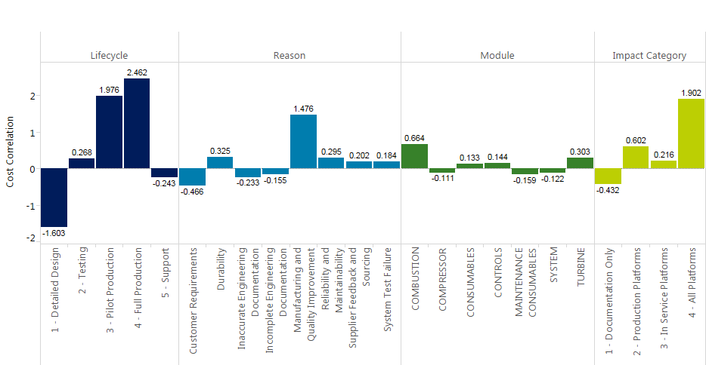
Further analyze data fields with strong correlations to create the basis for predictive models
Connected Data Sources
Data Profiling
Simulation of Improvements
Predictive Modeling

Slide 19

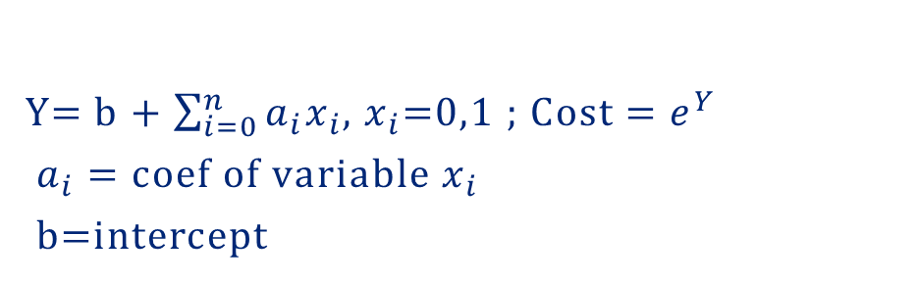
Calculate predictive model results using numerous correlations across structured and unstructured data
Connected Data Sources
Data Profiling
Simulation of Improvements
Predictive Modeling
Structured Data
Cost Prediction
PARAMETER | CORRELATION
Lifecycle | 2.724
Reason code | 2.462
Module | 2.203
PC Category | 1.873
Probability
Unstructured Data
Cost of Product Change
TEXT TOKEN | CORRELATION
Diameter | 2.790
Fire Test | 2.191
Air seal | 1.370
Zinc coating | 1.763
Y= b + $\sum_{i=0}^{n}{a_{i}x_{i}}$, $x_{i}$=0,1 ; Cost = $e^{Y}$
$a_{i}=coef of variable{ x}_{i}$
b=intercept

Slide 20
Solution Demonstration

Slide 21
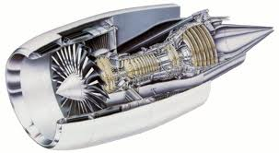


Demonstration scenario
Addressing the challenge required changes that impacted the total program lifecycle cost
  Program Profile
  Program Challenges
  Company Challenge
Volume of late changes
Speed of development
Missed supplier commitments
Manufacturability issues
Time
Cost of redesign
Test hardware cost
Tooling rework cost
Longer time to fully learn out cost
Support double digit growth with the same level of resources
Description | 3 Jet Engine Programs
Application | Light Weight Aircraft
Development Time | 4-5 years
Time in Service | 3-5 years
Total Parts per engine | 7,000 – 10,000
Engineered Parts per engine | 700-3,000
Cost
Frequent unscheduled service events
High support cost
Lack of collaboration between core engineering and support
Customer
Satisfaction

Slide 22
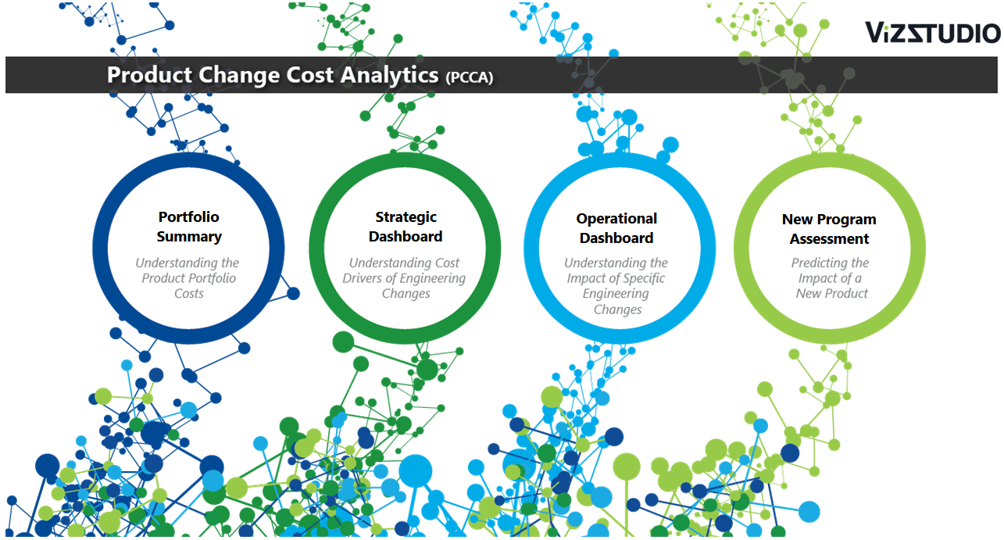
Solution Demonstration (screenshots provided for reference)
The demo is divided into four groups of dashboards to illustrate different levels of decision making abilities.

Slide 23
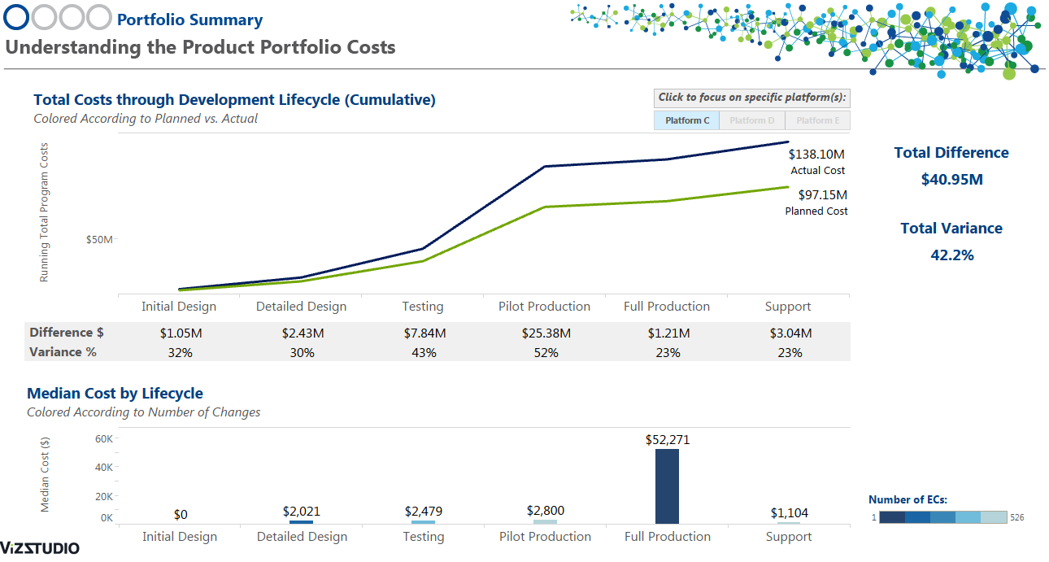
Portfolio Summary
The Portfolio Summary Dashboard sets the stage with a high level analysis of the three jet engine programs.

Slide 24
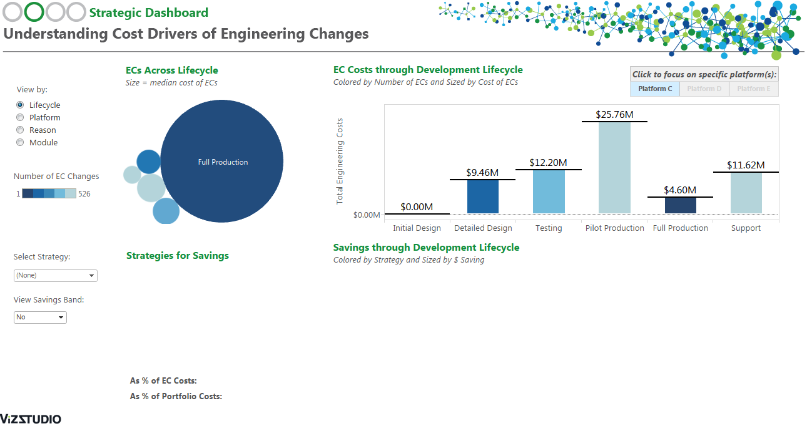
Strategic Dashboard (1 of 3)
The top half of the Strategic Dashboard provides a detailed look across each program’s total lifecycle cost.

Slide 25
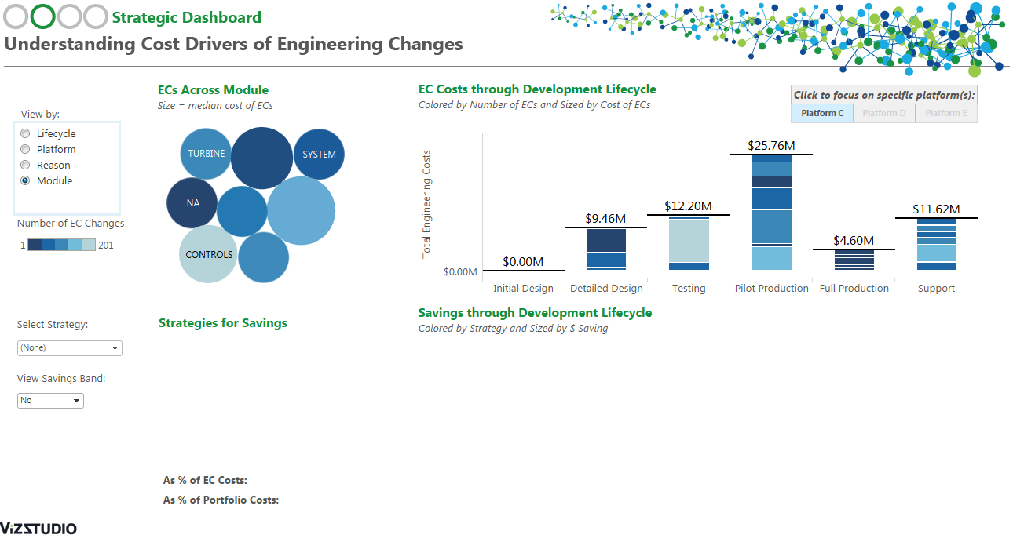
Strategic Dashboard (2 of 3)
Changing “View by” options allows the user to find cost drivers within a specific platform or all platforms.

Slide 26
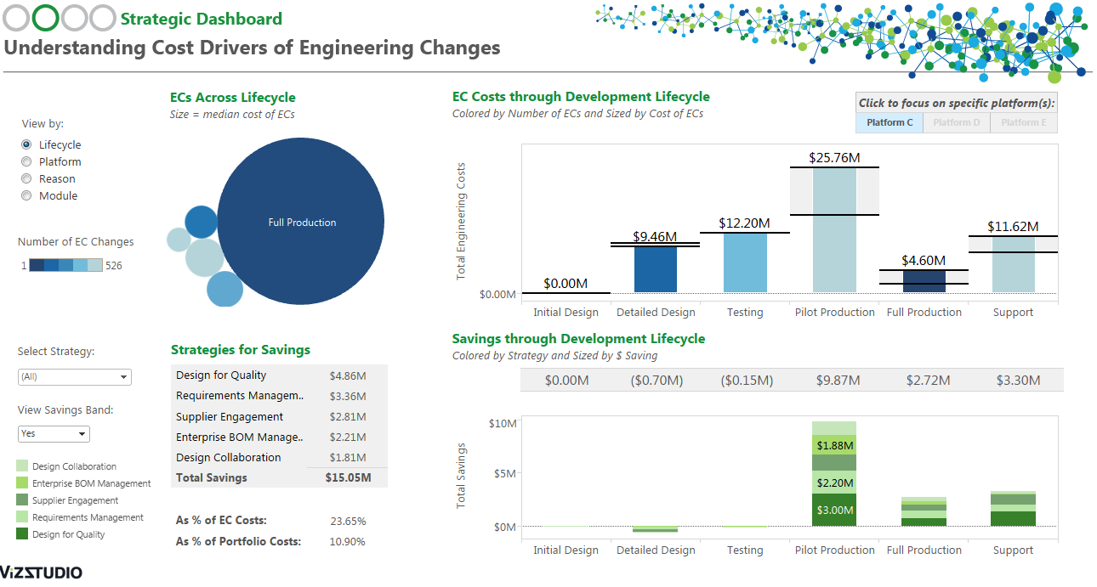
Strategic Dashboard (3 of 3)
The dashboard’s bottom half applies improvement strategy simulations and shows their potential savings.

Slide 27
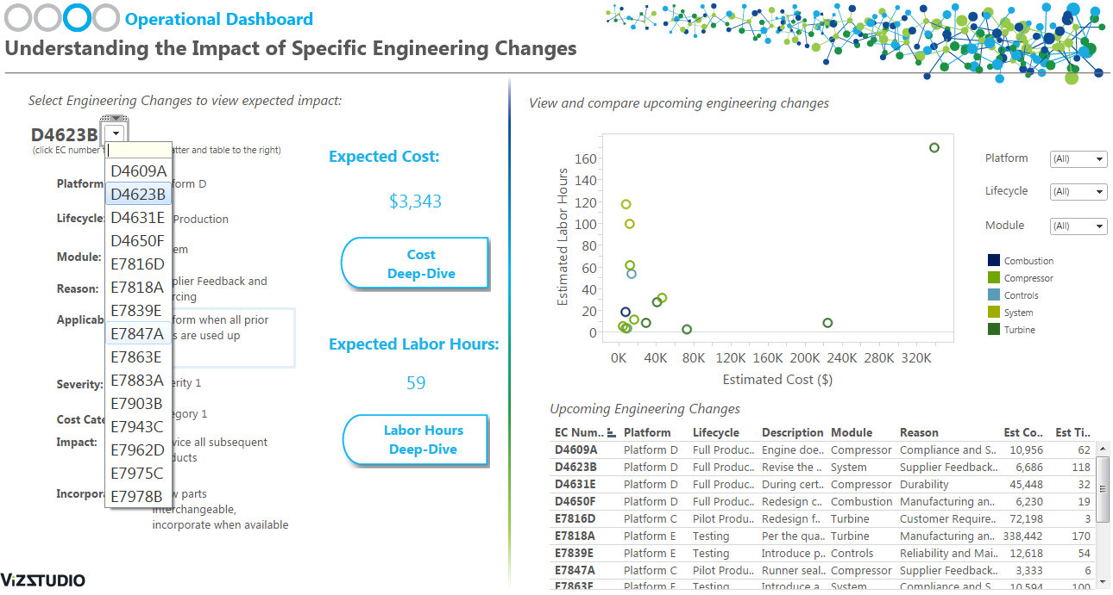
Operational Dashboard (1 of 3)
The Operational Dashboard predicts the cost and labor impacts of upcoming engineering change requests.

Slide 28
Operational Dashboard (2 of 3)
The Deep-Dive button takes the user to details about the prediction for individual engineering changes.

Slide 29
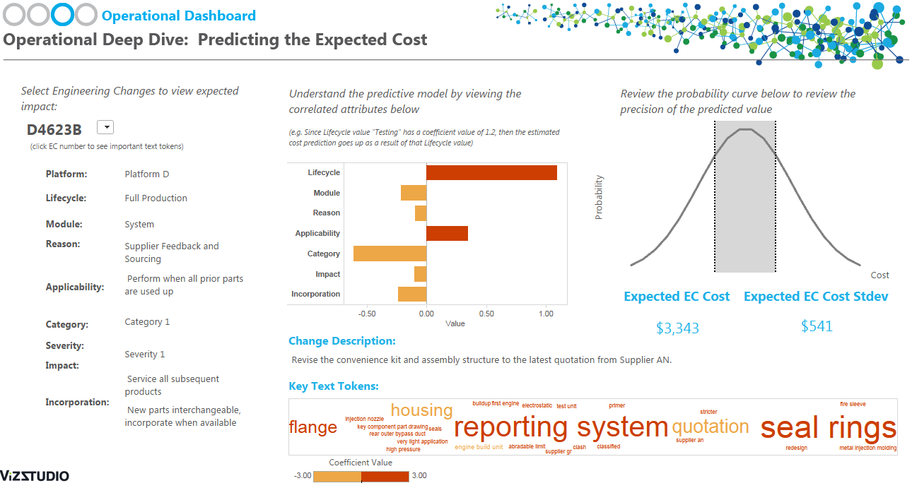
Operational Dashboard Deep Dive (3 of 3)
The Deep-Dive Dashboard breaks down the categorical parameters and text tokens used in the prediction.

Slide 30
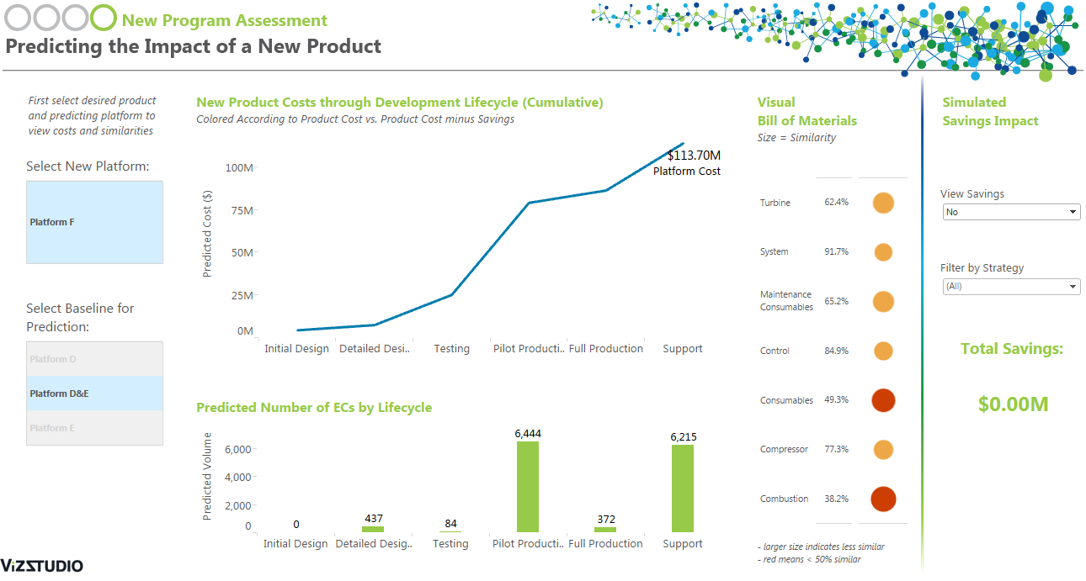
New Program Assessment (1 of 2)
The New Program Assessment analyzes module similarity from BOM data to predict upcoming program costs.

Slide 31
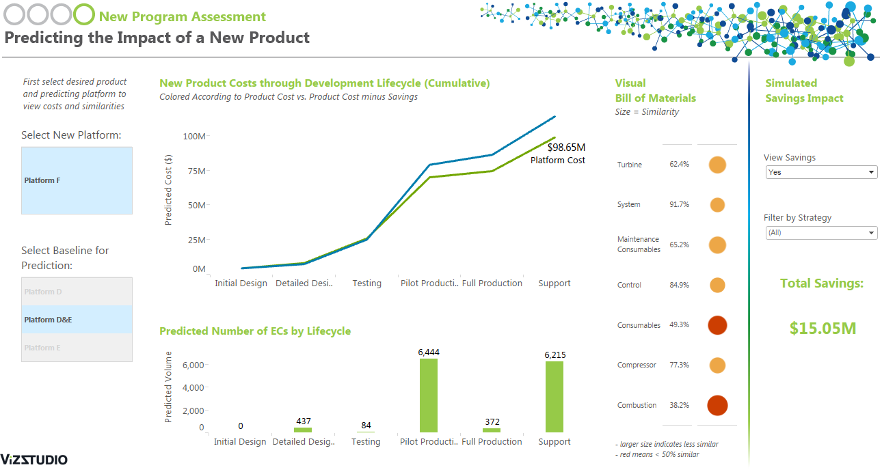
New Program Assessment (2 of 2)
Additionally, the dashboard applies improvement simulations to show savings in upcoming programs.

Slide 32
Data collection

Slide 33
Data collection activity
The graphic below represents the data types used in Product Change Cost Analytics. To accelerate the data collection, a Microsoft Excel template is available containing all the appropriate columns and additional instructions.
Product Change Records
DATA FIELDS
CHANGE NUMBER | ISSUE DATE | COMPLETION DATE | LIFECYCLE
REASON | AFFECTED MODULE | ESTIMATED HOURS | ACTUAL HOURS
PRIORITY | CHANGE CATEGORY | SOURCE | EC DESCRIPTION
Product Structure Data
DATA FIELDS
DATA TYPES
PART NAME | PART NUMBER | BILL OF MATERIALS | PRODUCT HIERARCHY
PART COST | MATERIAL | PARENT-CHILD RELATION
PART DESCRIPTION | MAKE OR BUY
Financial Records & Budget
DATA FIELDS
WBS NUMBERS | PROGRAM DATES | LIFECYCLE DATES
WBS NAME | COST & HOURS / MONTH | PLANNED COSTS
WBS DESCRIPTION | MILESTONE DATES
Other Data Sources
SERVICE BULLETIN RECORDS
PART REVISION HISTORY
UNSTRUCTURED DATA SOURCES

Slide 34
Closing
Ready for the next step?
Please contact us to learn more about how analytics can deliver value for your business.
Contacts
Brian Meeker
Principal
Deloitte Consulting LLP
bmeeker@deloitte.com
Dipen Parikh
Senior Manager
Deloitte Consulting LLP
diparikh@deloitte.com
Michael Cheung
Senior Consultant
Deloitte Consulting LLP
miccheung@deloitte.com
Jeff Pohl
Specialist Leader
Deloitte Consulting LLP
jpohl@deloitte.com

Slide 35

Notes:
35

